Slide 1
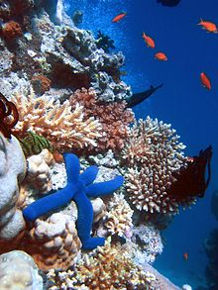
The Coral Reef Biome

Slide 2
Global location’s
In the world there are Coral Reefs in
Southeast Asia
The Pacific including Australia.
And in the Atlantic and Caribbean

Slide 3
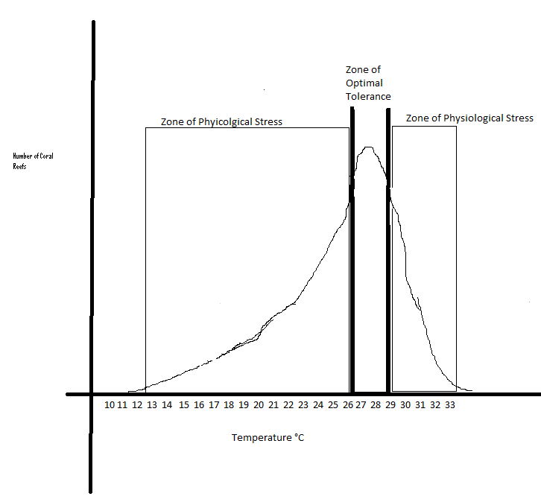
Temperature and Precipitation ranges of a Coral Reef
The optimal range of tolerance for the temperature of a coral reef is 26–27°C,
Although many exist in the range of 20-29°C
Few reefs exist in waters below 18 °C (64 °F).
However, reefs in the Persian n Gulf have adapted to temperatures of 13 °C in winter and 38 °C in summer.
The precipitation for a coral reef has a minimal effect because a coral reef is within an ocean.

Slide 4
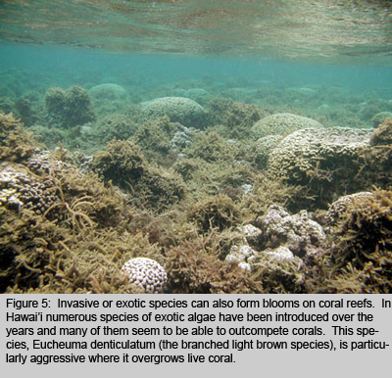
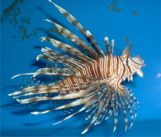
Invasive Species:
Marine algae have been:
Introduced to Hawaiian reefs.
For experimental aquaculture
Lionfish (Pterois volitans and P. miles)
Venomous spines.
No natural predators
Reproduces: a single female produces more than two million eggs per year.
Can live in many diverse habitats.

Slide 5
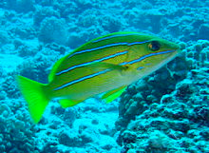
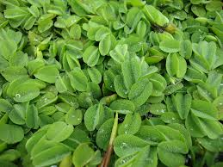
Blue Line Snapper
Outcompetes other fish
Dominates other fish for habitat in reefs.
Parasitic nematode was a disease that was introduced to the coral reefs in Hawaii when the Blue Line Snapper was released.
Salvinia
In 2003 Lake Wilson was over run with Salvinia.
Cost Hawaii over one million dollars to clean up Lake Wilson.
Outcompetes other fish for nutrients.

Slide 6
Important Abiotic Factors
Light:
Key for the mutual relationship between coral and zooxanthellae.
Intensity of light affects the growth and nutrition of the coral.
Substrate:
Environment in which an organism lives.
Surface on which an organism grows or is attached
Wave forces:
The Intensity of waves impacts the everyday life of coral reefs.
Sediment:
The amount of sediment dirt rocks etc.. affect the coral reef by the amount of stone and dirt in the biome.
Temperature:
Coral grows optimally at water temperatures between 25-29°C.

Slide 7
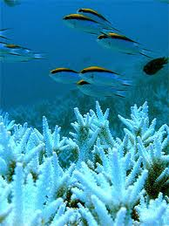
Ecological Services
Coral reefs are among the most productive and biologically diverse ecosystems on Earth
Produces10 percent of the fish consumed by humans(Smith, 1978).
Recreational possibilities.
Coastal protection
Aesthetic and cultural benefits.
Buffers Waves and Currents

Slide 8
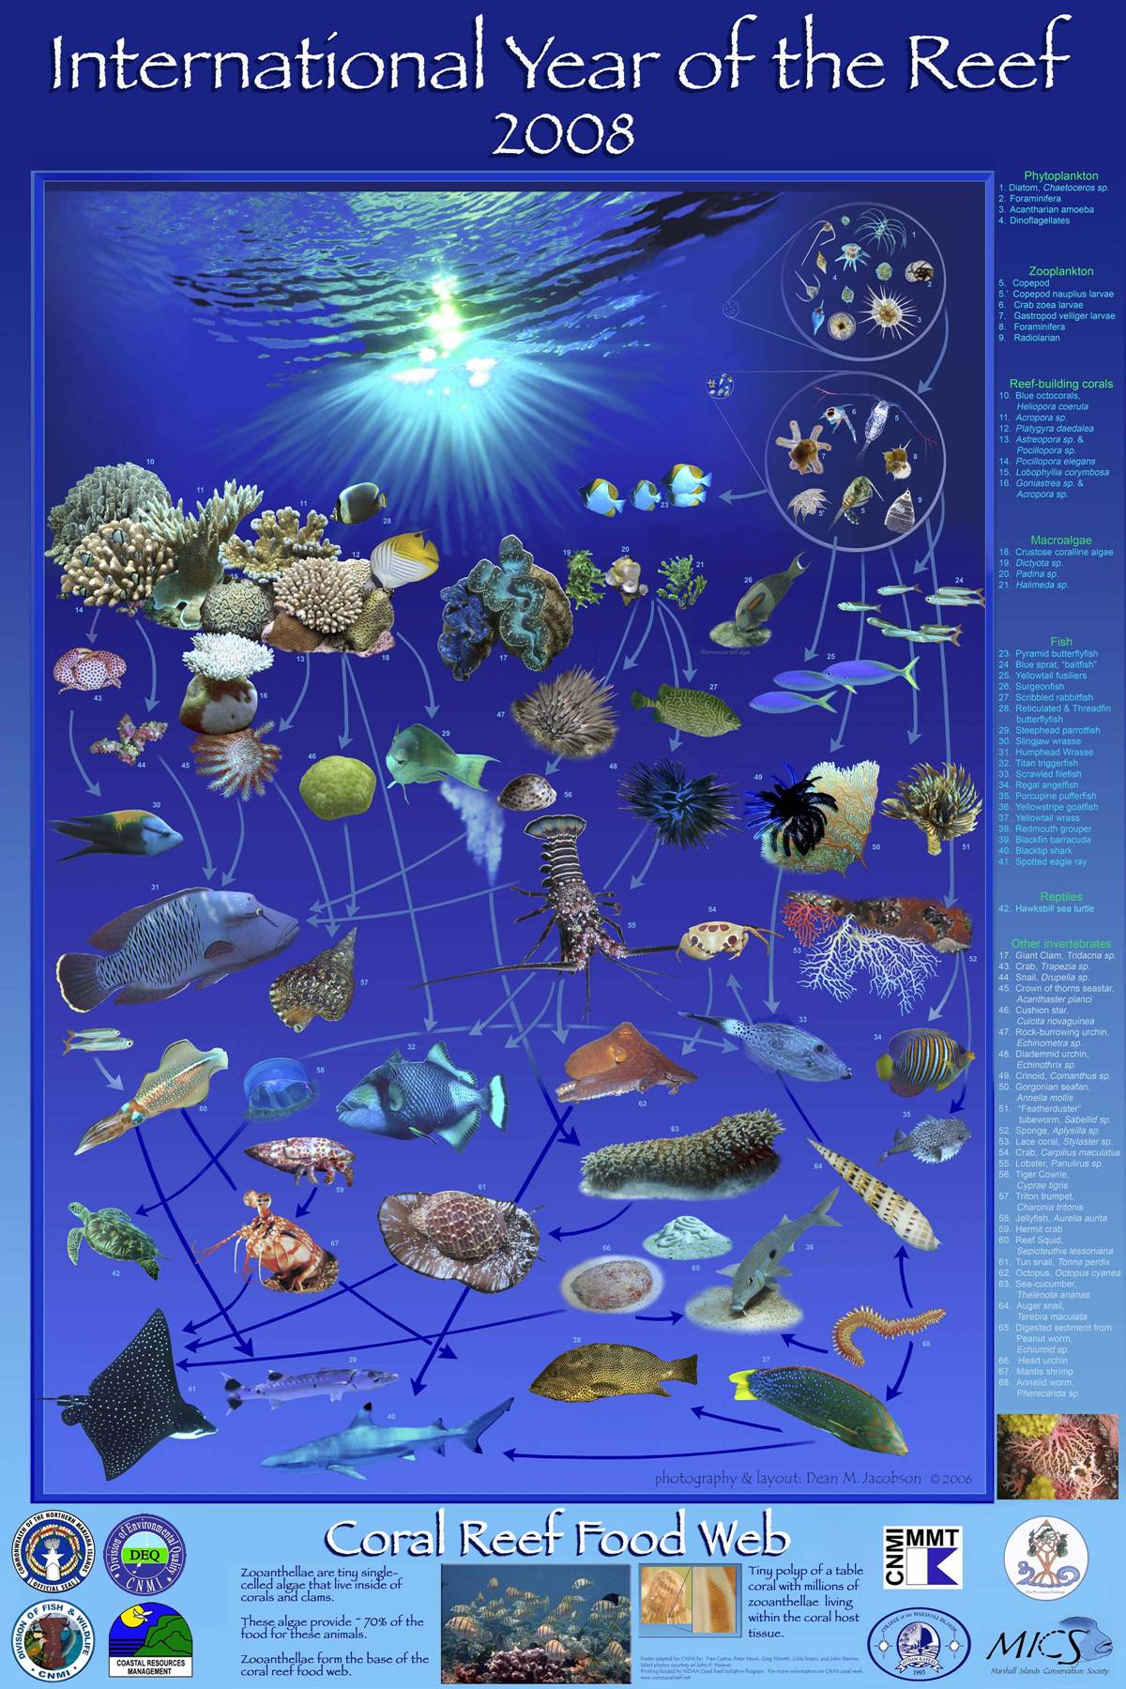

Slide 9
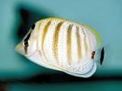
Indicator Species
The distribution and
amount of these fish are directly correlated with the distribution and amount of coral.
If the corals are adversely affected by stressful environmental conditions, such as:
chronic low levels of pollution, their health will deteriorate.
This deterioration should is the fishes which feed on them
Pebbled Butterfish (Chaetodon multicinctus)

Slide 10
Resource Partitioning
There are hard-skeleton coral that gains food from taking planktonic animals in their tentacles and,
In exchange for providing a suitable habitat and nutrients, gain extra sources of energy from sugar-synthesizing symbiotic alga

Slide 11
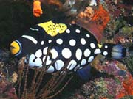
Common Animals
Clown Triggerfish:(Balistoides conspicillum)
is believed to deter potential predators. As with most other triggers, the clown is an lown Triggerfish (Balistoides conspicillum)The clown triggerfish is without a doubt the most beautiful member of the trigger family. The bright yellow mouth is believed to deter potential predators. As with most other triggers, the clown is an aggressive feeder, feeding mainly on crustaceans and mollusks. They use their strong jaws to crack open the shells of mollusks and crabs.
aggressive feeder, feeding mainly on crustaceans and mollusks. They use their strong jaws to crack open the shells of mollusks and crabs.

Slide 12
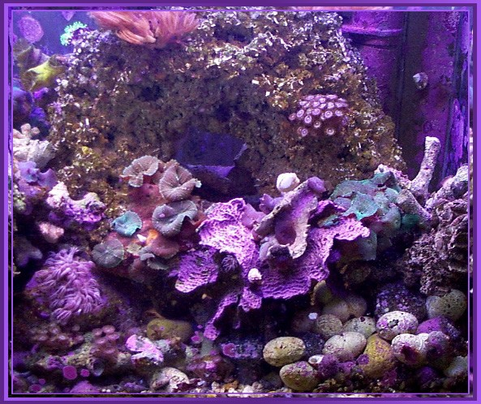
Common Plants
Coralline Algae:
These spread out in thin layers over the surface of the ocean bed. They are made of masses of very fine thread-like filaments, and these filaments produce calcium carbonate, which in turn gives these algae a rock-like appearance.
Calcareous Algae:
Produce calcium carbonate (limestone),
Known to grow erect.
The limestone in turn produces the sand that is found on the beaches when these dissolve.

Slide 13
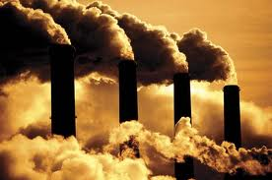
Threats to the Biome
The threat of Co2
The oceans have absorbed 525 billion tons of carbon dioxide from the atmosphere.
Warming oceans
Kills the ecosystem
Harms animals, plants, coral reef.
The absorption of carbon dioxide are lowering seawater pH

Slide 14
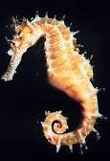
Animal Adaptations
Seahorses:
have curly tails to hook on the coral reefs to avoid being swept away
Sea Anemone:
have suckers that helps them to secure themselves to coral reefs

Slide 15
Keystone Species
Ivory tree coral (Oculina varicosa)
This Caribbean coral is a slow growing and delicate branching coral whose thickets provide a home to various reef fish
These corals have been devastated by fishing practices such as bottom trawling which has killed about 30 percent of the Ivory Tree coral population.

Slide 16
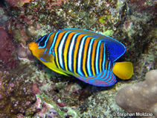
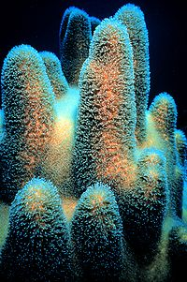
Endemic Species
Regal Angelfish
Coral

Slide 17
Works Cited
Hughes, Terence P. "Catastrophes, phase shifts, and large-scale degradation of a Caribbean coral reef." SCIENCE-NEW YORK THEN WASHINGTON- (1994): 1547-1547.
Bellwood, D. R., et al. "Confronting the coral reef crisis." Nature 429.6994 (2004): 827-833.
Allen, Gerald R. "Conservation hotspots of biodiversity and endemism for Indo‐Pacific coral reef fishes." Aquatic Conservation: Marine and Freshwater Ecosystems 18.5 (2008): 541-556.
Roberts, J. Murray, Andrew J. Wheeler, and André Freiwald. "Reefs of the deep: the biology and geology of cold-water coral ecosystems." Science312.5773 (2006): 543-547.
Hixon, Mark A., and William N. Brostoff. "Damselfish as keystone species in reverse: intermediate disturbance and diversity of reef algae."Science(Washington) 220.4596 (1983): 511-513.
Moberg, Fredrik, and Carl Folke. "Ecological goods and services of coral reef ecosystems." Ecological economics 29.2 (1999): 215-233.
Porter, James W. "Autotrophy, heterotrophy, and resource partitioning in Caribbean reef-building corals." The American Naturalist 110.975 (1976): 731-742.
Reese, Ernst S. "Predation on corals by fishes of the family Chaetodontidae: implications for conservation and management of coral reef ecosystems."Bulletin of Marine Science 31.3 (1981): 594-604.
Hatcher, B. G., and A. W. D. Larkum. "An experimental analysis of factors controlling the standing crop of the epilithic algal community on a coral reef."Journal of Experimental Marine Biology and Ecology 69.1 (1983): 61-84.

